Slide 1


Intro to HTML and CSS
September 14, 2019

Slide 2
Agenda
Introduction
About Women++
About Propulsion Academy
Intro to HTML
Livecoding
Break
Intro to CSS
Livecoding together
Break
Individual work

Slide 3

women++
We are a Swiss non-profit association which is on a mission to support women in building and leading their careers in programming-related fields

Slide 4
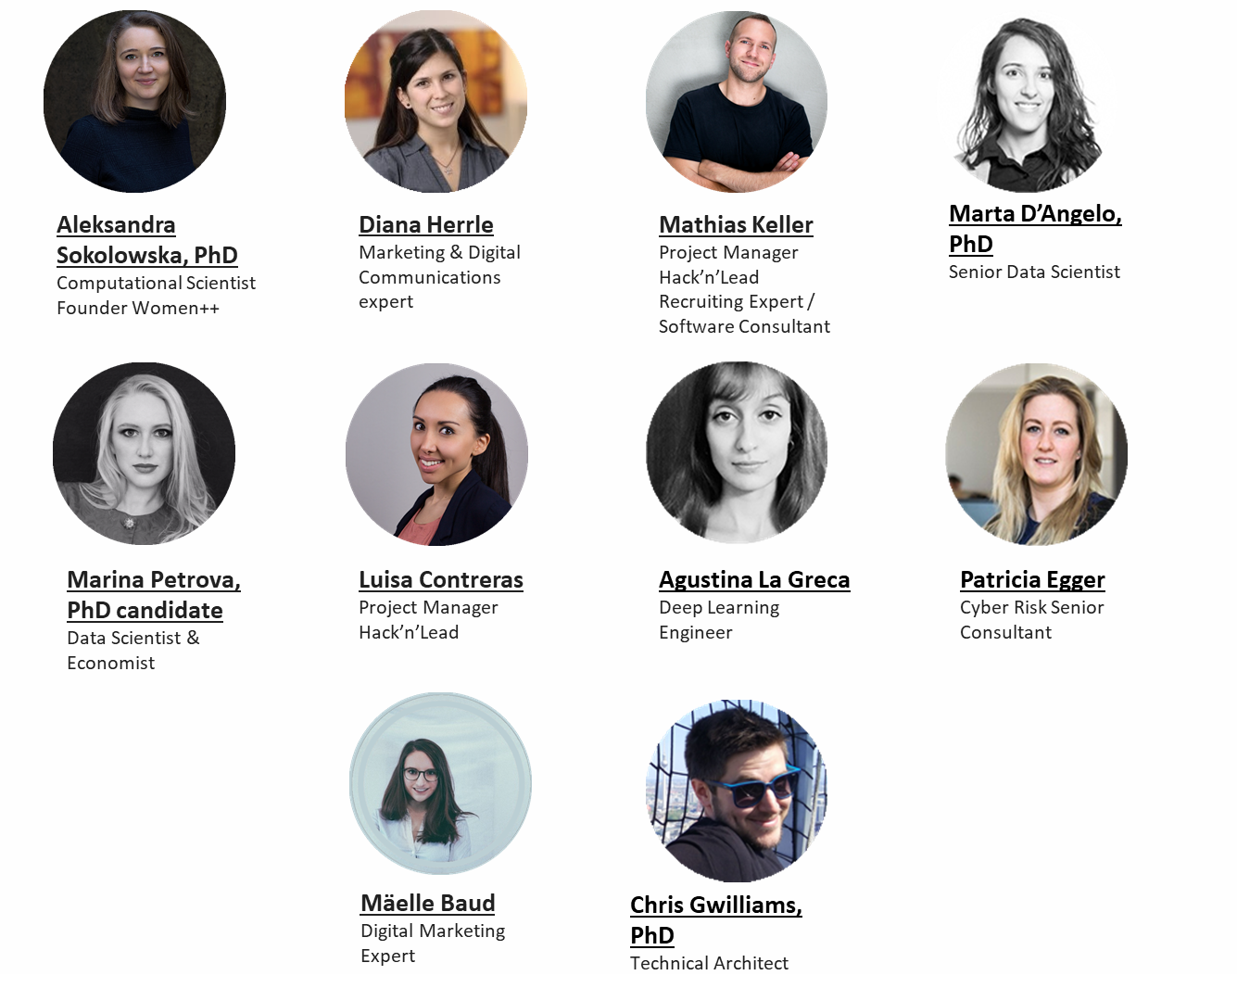
Team

Slide 5
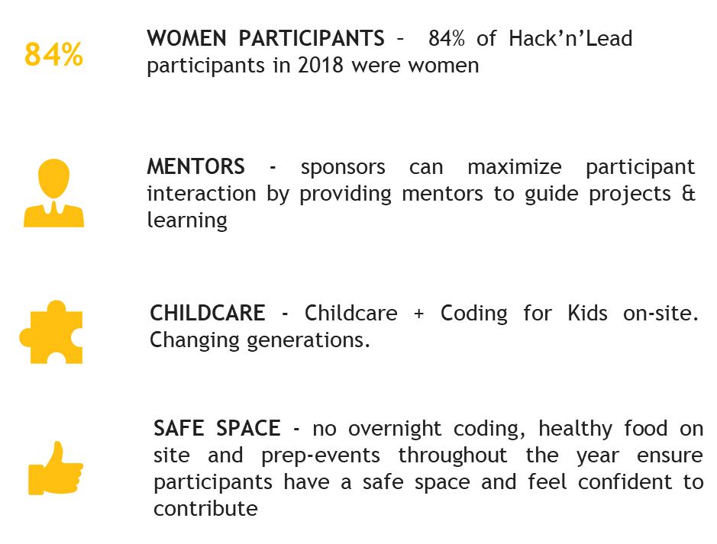


Hack’n’Lead
www.hackandlead.com

Slide 6
Our workshop program https://www.womenplusplus.ch/prep
Workshop | Date | Expert | Description
Survival Kit for your first Hackathon | 25.08.2019 | Chris Gwilliams | 1. Panel of former participants 2. Technical part with Chris Gwilliams - Opening the command prompt (Linux and Windows) - Basic commands and directory navigation - What Git is, how to use it and creating a basic website
Statistical methods for data analysis - machine learning | 31.08.2019 | Pietro Marino, Pavlin Mavriodiev and Badru Stanicki | 1. Overview of most common algorithms 2. Practice on feature selection & clustering 3. Practice on forecast
Web Development: intro to HTML and CSS | 14.09.2019 | Tatiana Panferova, Evgenia Tokareva | 1. Introduction to HTML 2. Basics of CSS 3. Exercises
Introduction to GraphQL Workshop - back-end | 17.09.2019 | Marion Schleifer | 1. Introduction into GraphQL 2. sample project with Hasura's GraphQL API
Build Solid Web Apps using Angular and GraphQL | 24.09.2019 | Tomas Trajan and Gion Kunz | Creating a front-end web application using Angular
Courage to LEADership | 22.10.2019 | Gabriela Müller Mendoza | hands-on examples and exercises to help you achieve and master your next career milestones

Slide 7
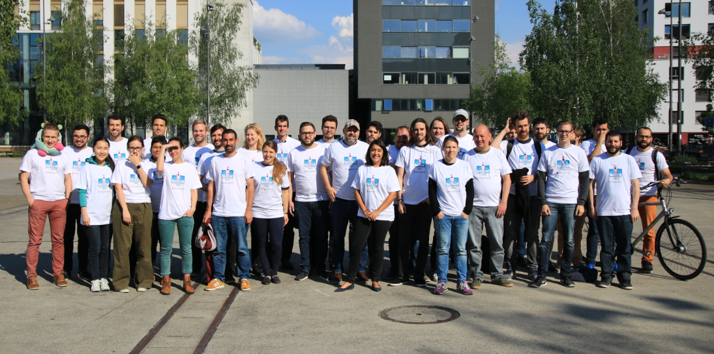


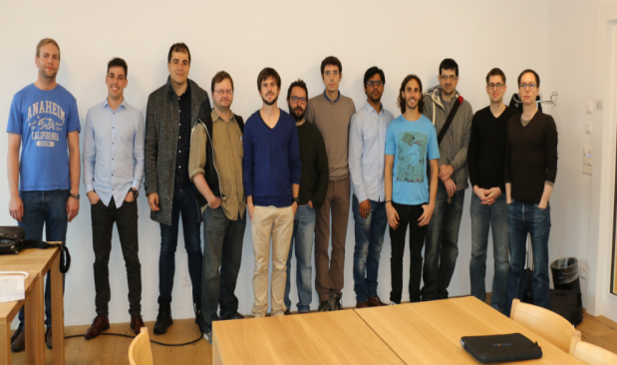
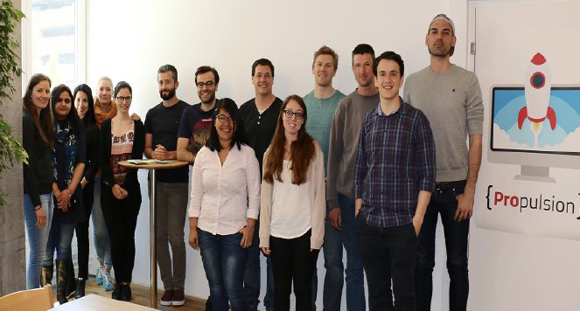
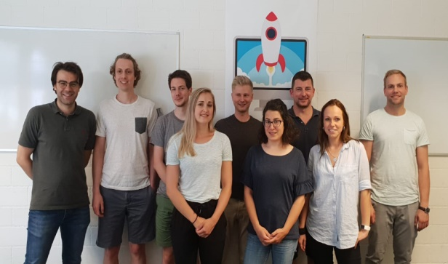

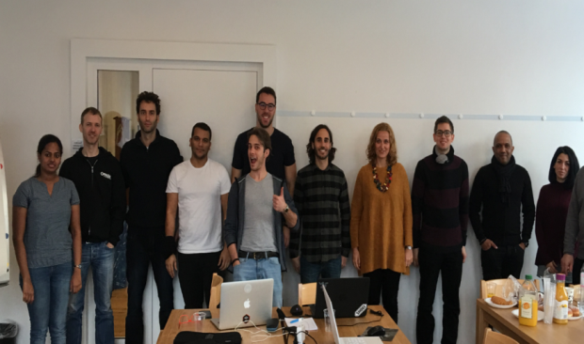
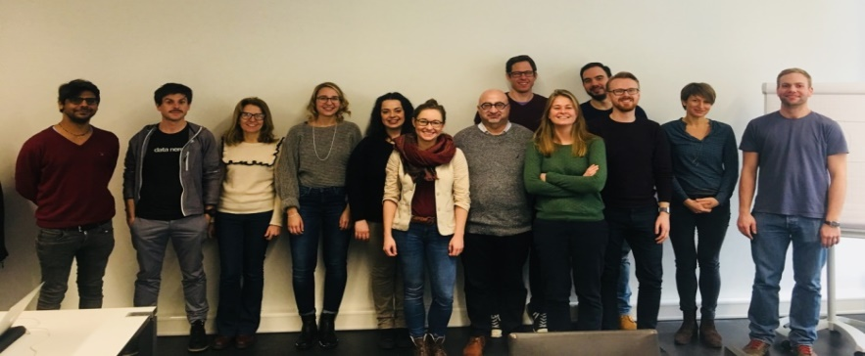
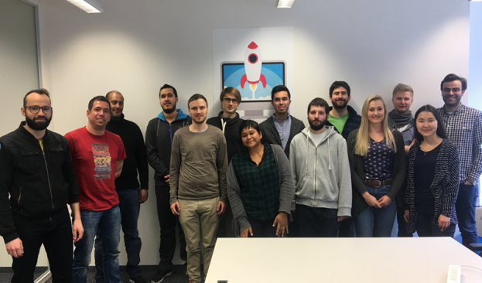
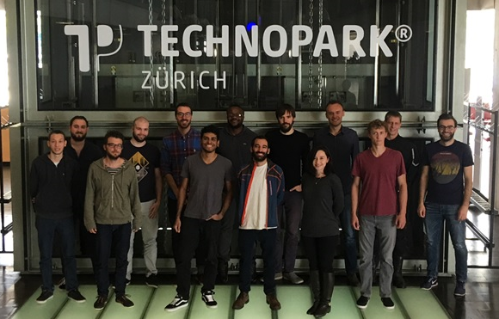
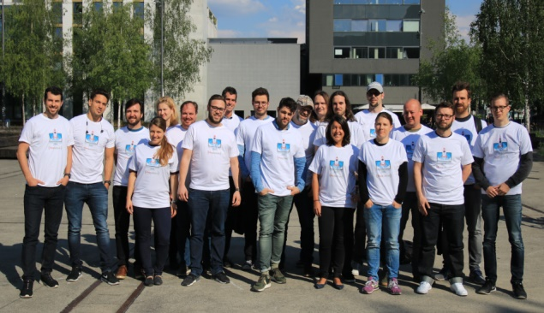
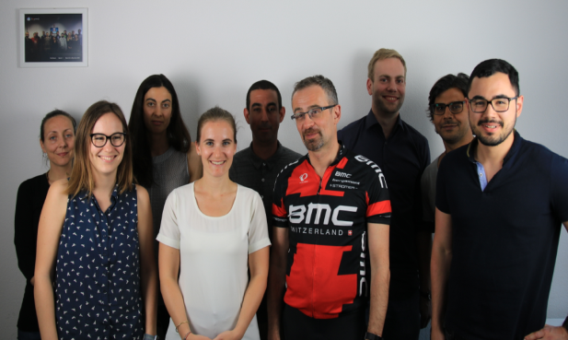

Propulsion Academy
Full and part-time Full-Stack Development, Data Science, Big Data Engineering bootcamps
Hands-on and project-oriented approach
Curricula representing actual industry needs
Incubator-like atmosphere

Slide 8
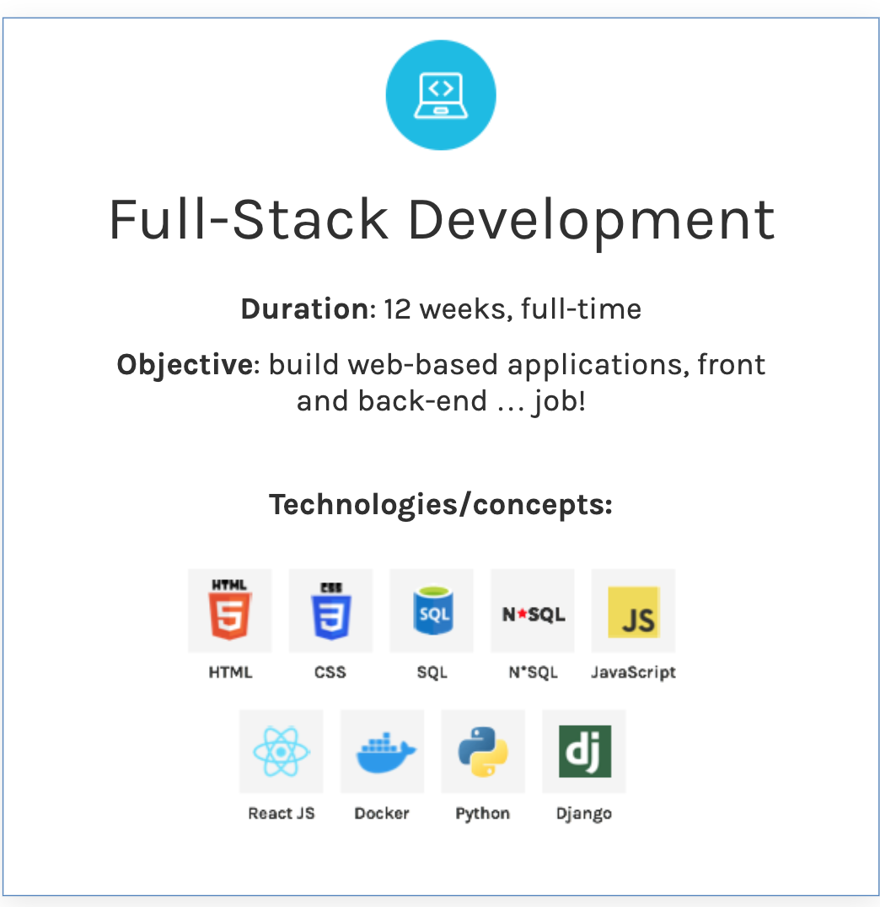
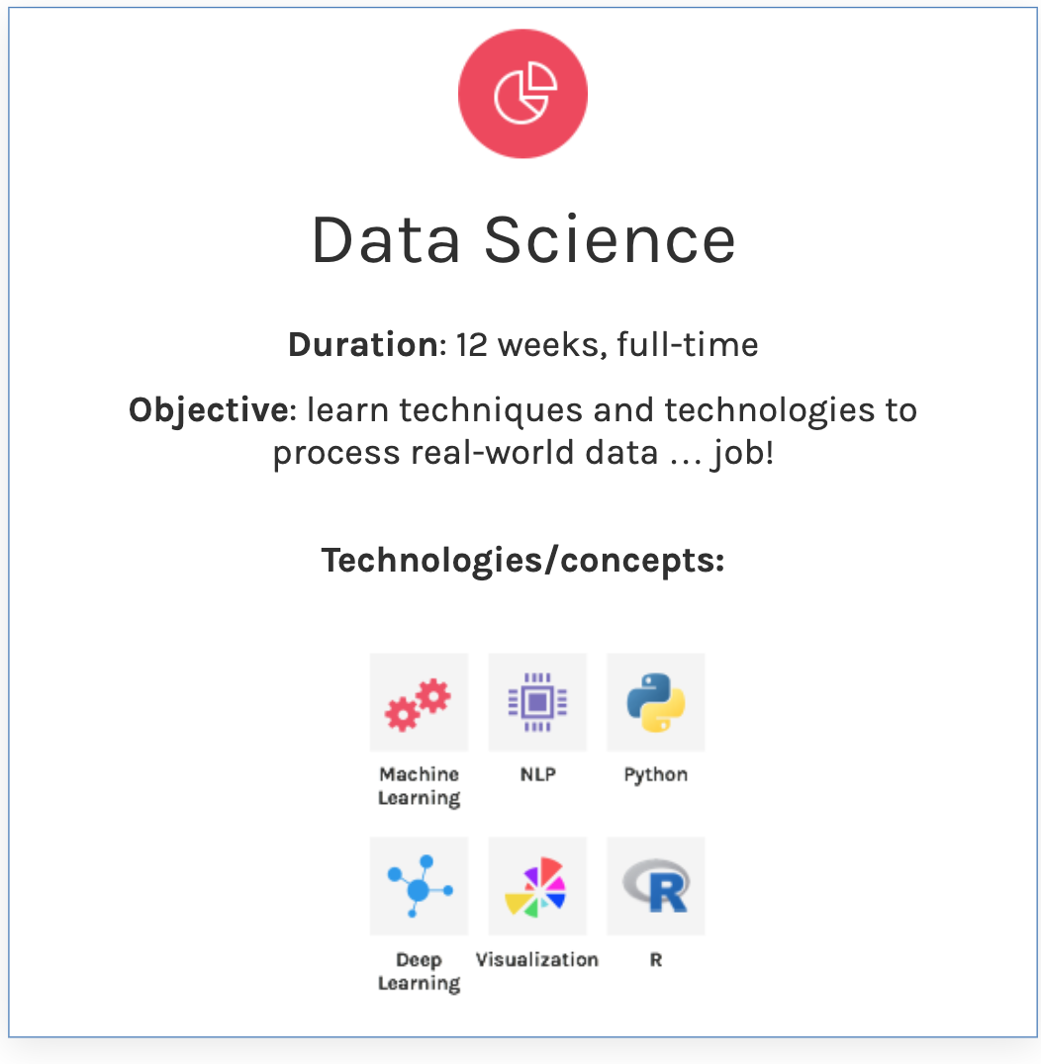
Core programs, full-time:

Slide 9
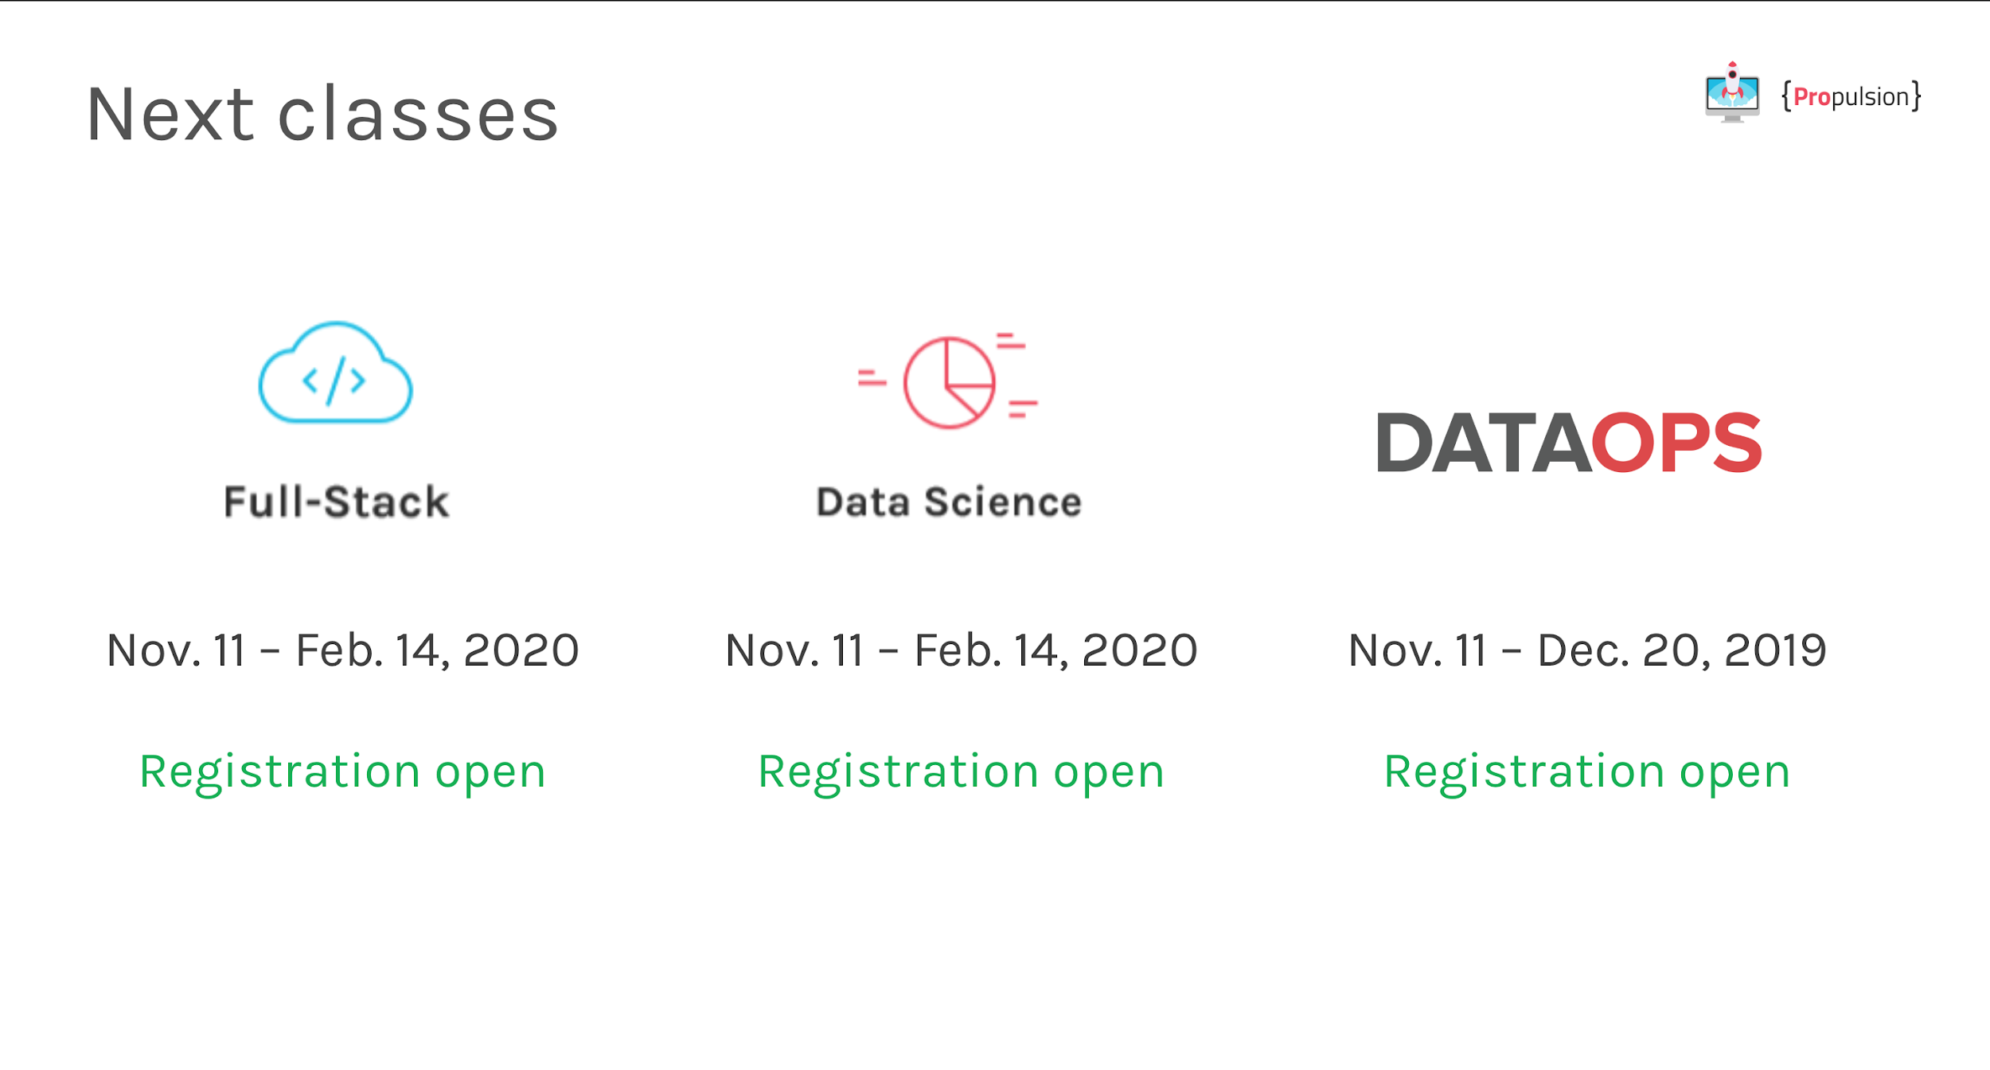

Slide 10
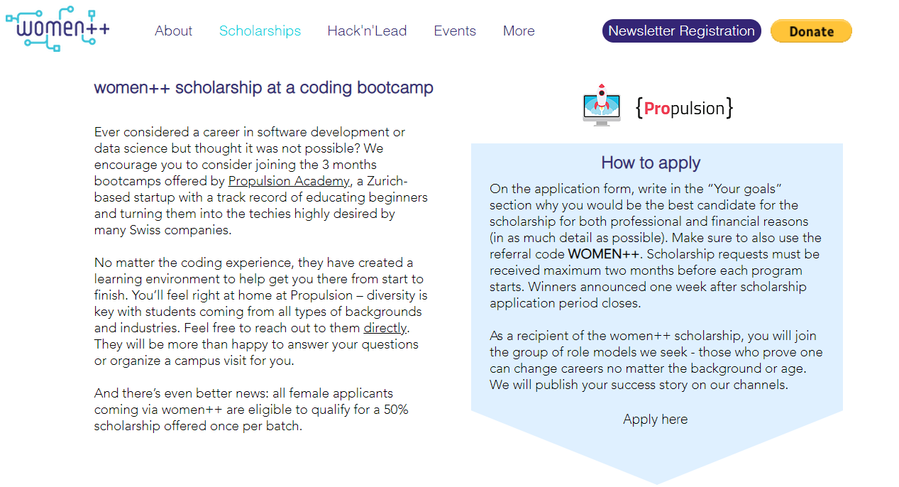
women++ scholarships
https://www.womenplusplus.ch/scholarships

Slide 11
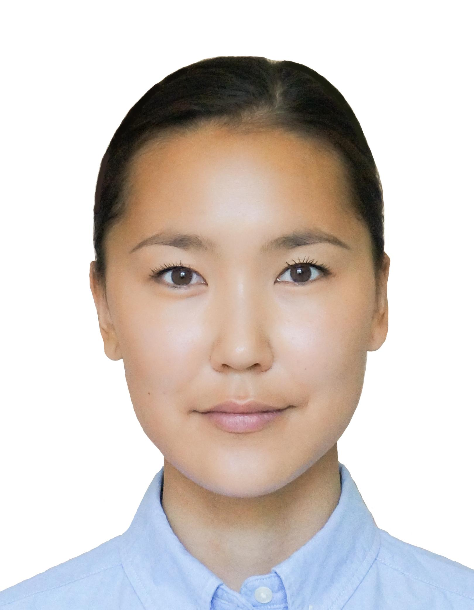

About Us
Evgeniya Tokareva
https://www.linkedin.com/in/evtokareva/
Tatiana Panferova
https://www.linkedin.com/in/tatiana-panferova/
https://github.com/TatianaPan

Slide 12
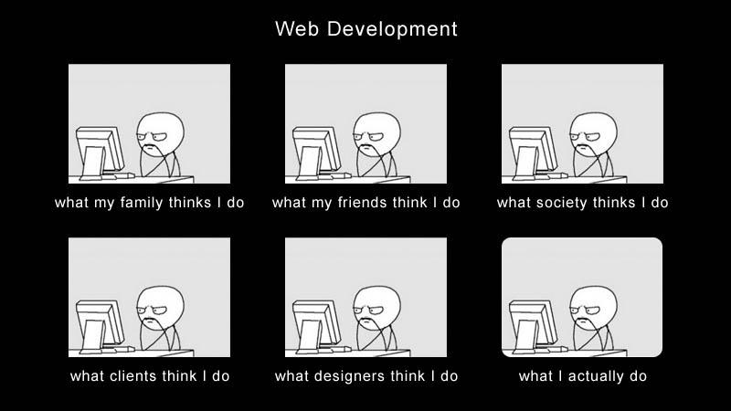
Before we start...

Slide 13
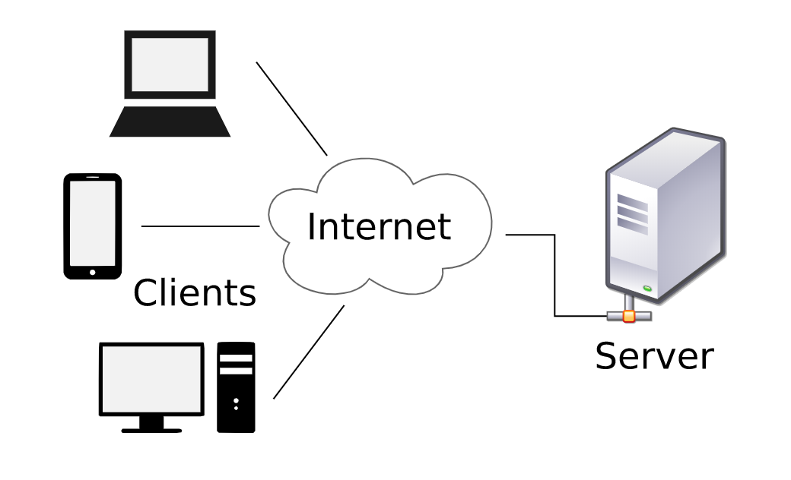
Client-server model

Slide 14


Slide 15
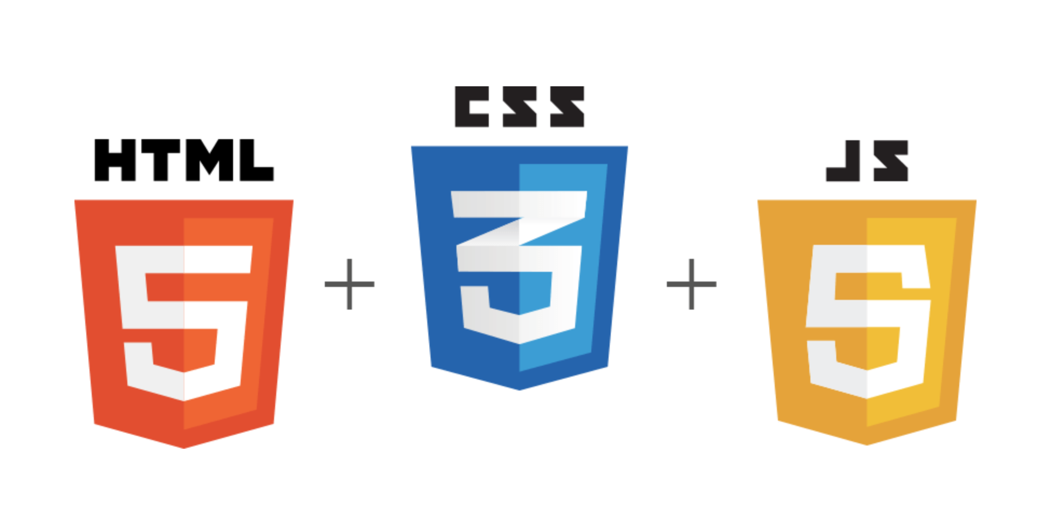
Frontend

Slide 16
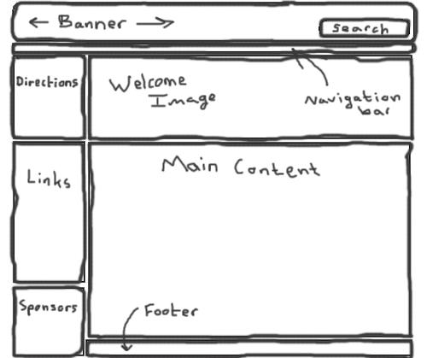
Create a draft

Slide 17
What is HTML?
HyperText Markup Language

Slide 18
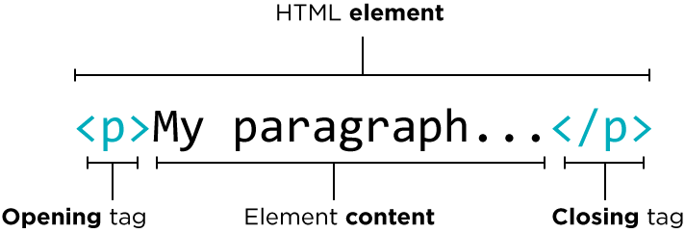
HTML Element

Slide 19
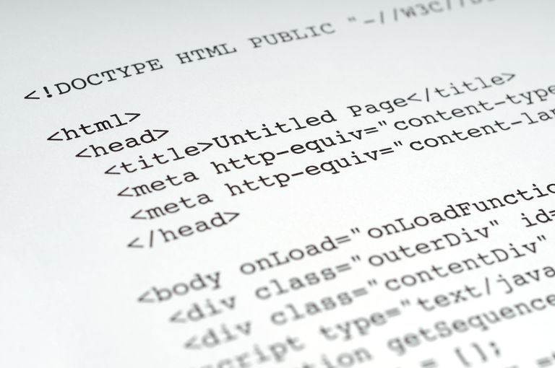
Main HTML
Tags
List of all tags:
https://developer.mozilla.org/en-US/docs/Web/HTML/Element

Slide 20
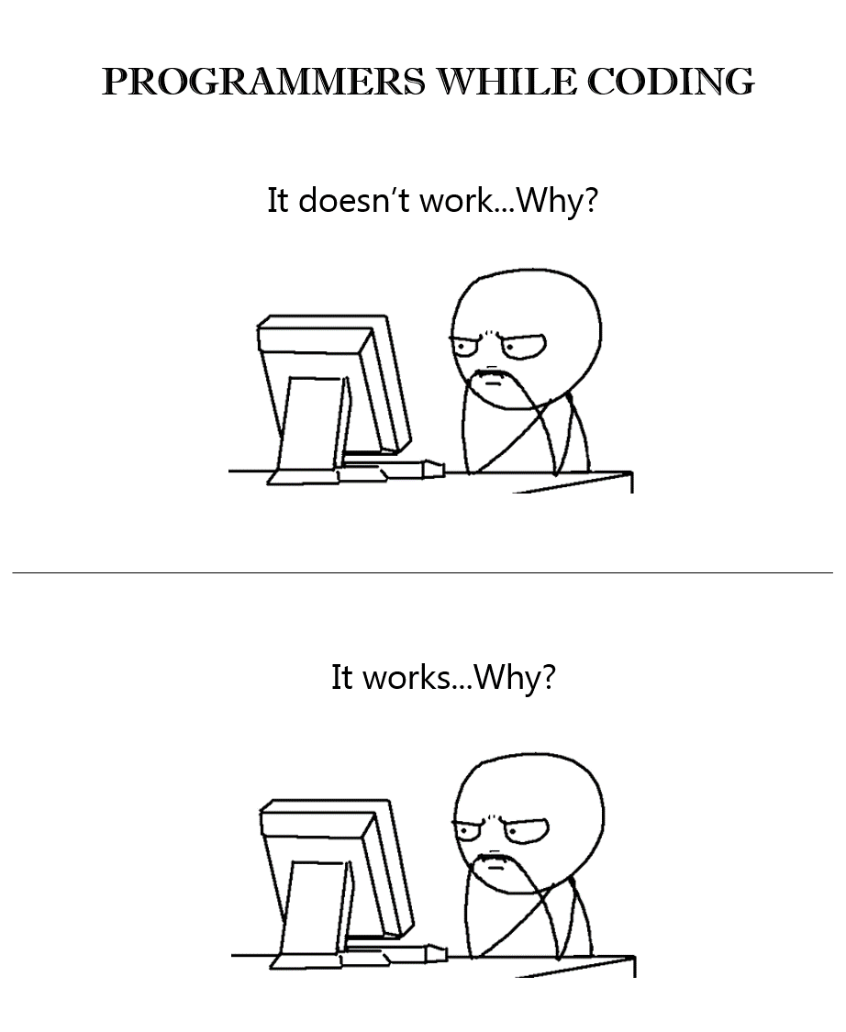
Time to code!

Slide 21

You have just created your first
static web site!

Slide 22
Useful Links
MDN: https://developer.mozilla.org/en-US/docs/Learn
W3Schools: https://www.w3schools.com/
Codecademy: https://www.codecademy.com/catalog/subject/web-development
freeCodeCamp: https://learn.freecodecamp.org
Templates: https://www.wix.com/
Frameworks: https://materializecss.com/, https://bulma.io/

Slide 23
Your turn!

